Slide 1
Measuring the pseudorapidity distribution of charged particles in proton-proton collisions at √s=13 TeV with the ALICE Experiment at the Large Hadron Collider
Xiaoyu Liu
(CERN)
Supervisors:
Prof. Paolo Bartalini & Dr. Prabhakar Palni (Central China Normal University)

Slide 2
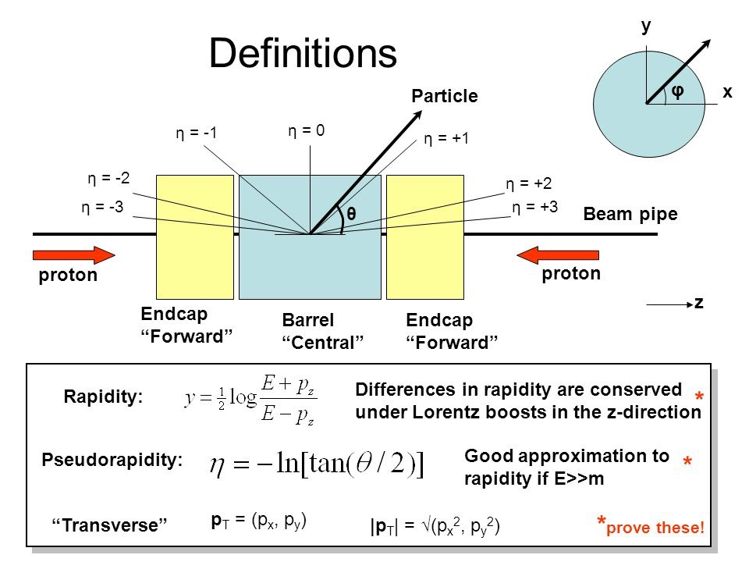
Pseudorapidity Density Distribution (dN_{ch}/dη)
Number of primary charged particles detected in a given Pseudorapidity (𝜂) interval in single proton-proton collisions (which we call “events”).
Some Common Definitions in particle physics.
Δy intervals are
relativistic invariant
→
Δη intervals (hence dN/dη densities) are
relativistic invariant in the massless approximation

Slide 3
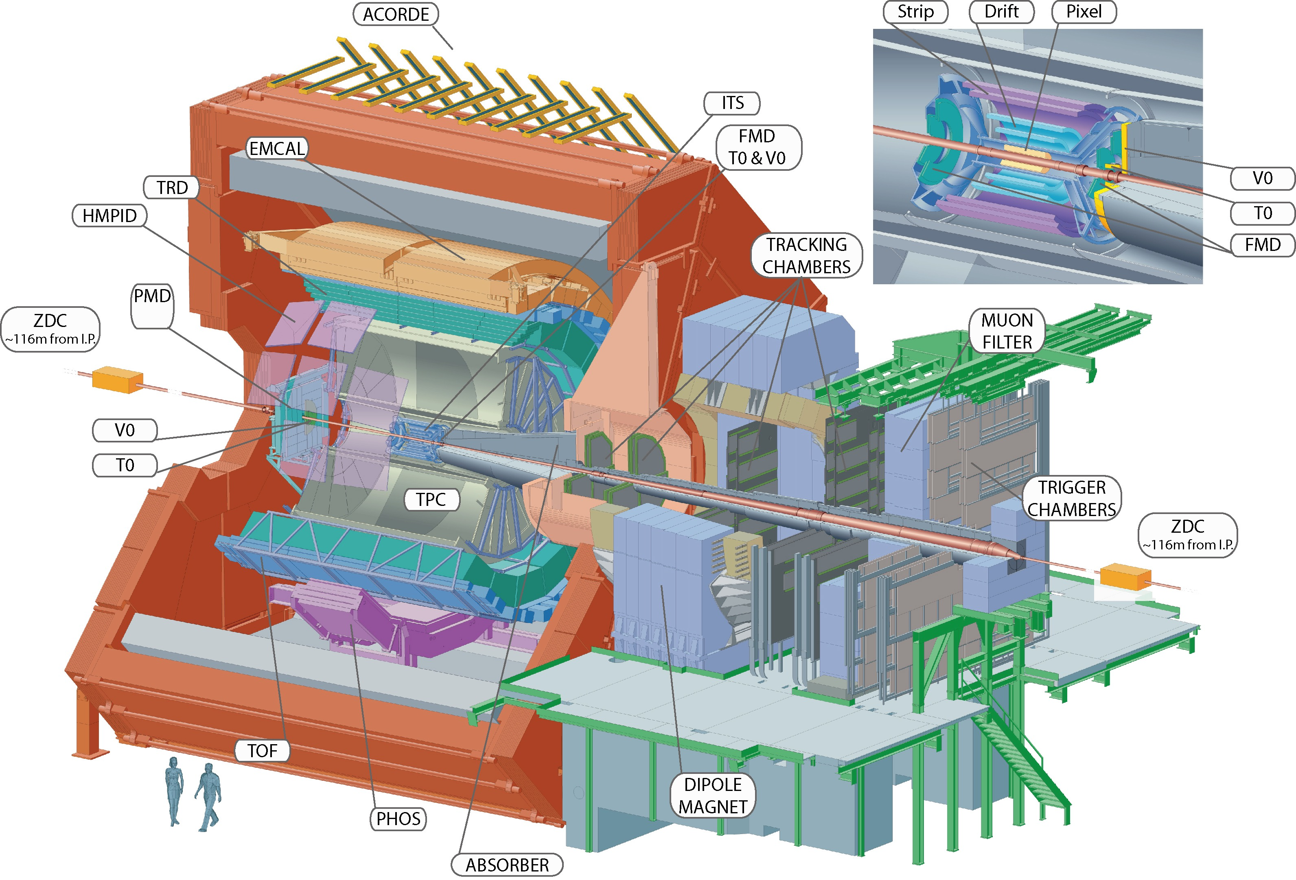
The ALICE detector
Tracking Detectors: Inner Tracking System (ITS) and TPC.
Triggering Detectors: V0A, V0C (and other forward detectors).

Slide 4
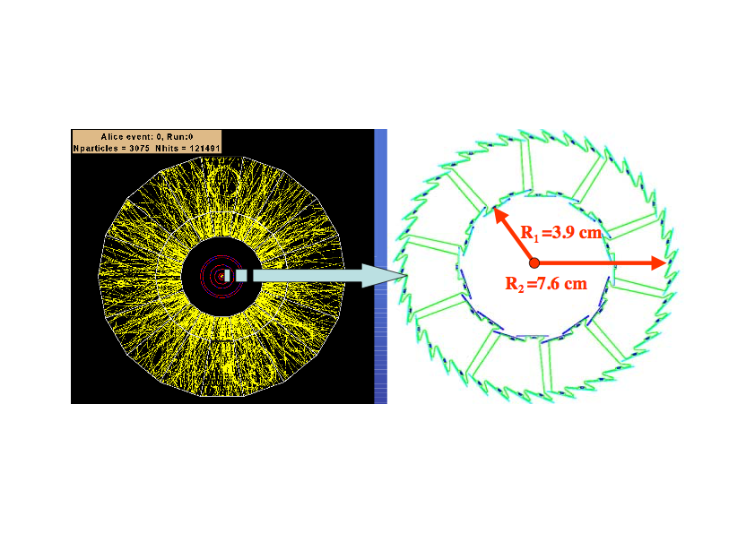
The ALICE Silicon Pixel Detector (SPD)
It consists of two layers, inner (3.9 cm) and outer (7.6 cm) layer

Slide 5
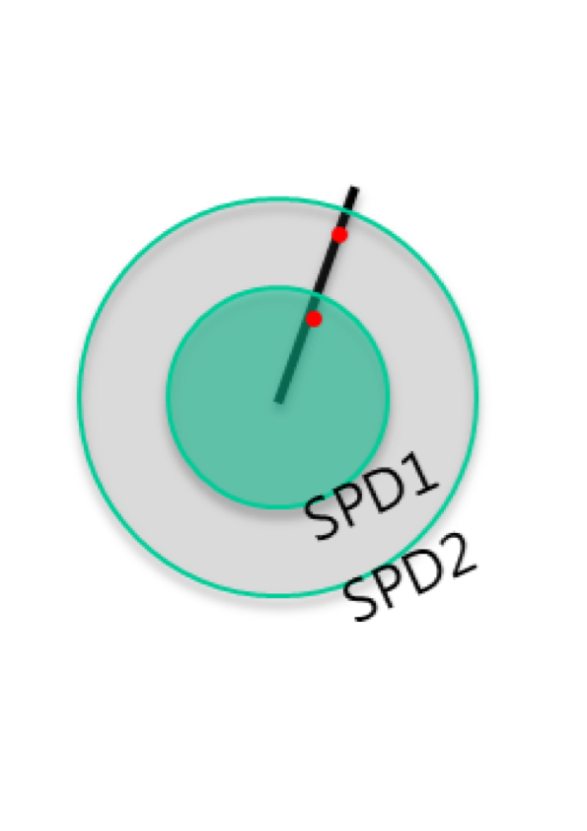
Tracklet Reconstruction in the SPD
When the primary charged particles pass through the SPD detector layers produce hits (clusters of electrons and holes).
An SPD tracklet is a short segment, reconstructed using the position of the primary vertex and one hit each on the inner and outer SPD layers.

Slide 6
From Trackelts to Charged Particles
The charged-particle pseudorapidity density distribution is computed as
Ntracklets Number of SPD tracklets
𝛼 Acceptance times the efficiency for a primary charged-particle to produce a tracklets
𝛽 Contamination of Reconstructed tracklets from combinatorial background

Slide 7
Event Selection
Two normalization classes are used, INEL and INEL > 0
Inelastic event selection (INEL):
Events are selected with Minimum Bias trigger with logical OR of detector hits defined as (V0A || V0C || ADA || ADC).
Inelastic event with at least one charged particle (INEL > 0):
Events selected with at least one reconstructed SPD tracklet (charged particle) in an event within the region |η| < 1. 0.
The Pseudorapidity distribution of charged particles is measured for both INEL and INEL > 0 normalization classes.

Slide 8
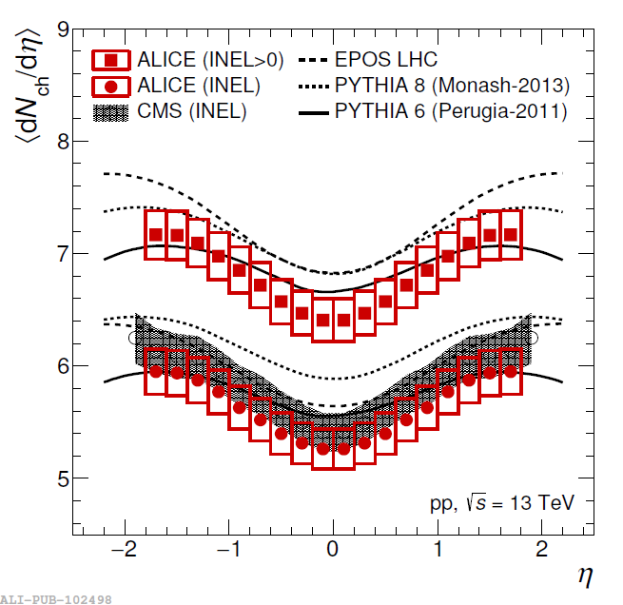
Single charged particle spectra: dN_{ch}/dη
Phys.Lett. B 753, 319 (2016)
i.e. the first ALICE publication in RUN II
My task as summer student in the ALICE High Multiplicity Task Force (HMTF) is to contribute to the extension of this measurement in High Multiplicity Final States.
dN/dη_{|η|<0.5} ≈ 10 x〈dN/dη_{|η<0.5}〉
ALICE has a unique opportunity to collect a large sample of low pile-up High Multiplicity pp data in RUN II.

Slide 9
My contribution to the dN_{ch}/dη measurement in High Multiplicity Events
Quality Assurance (QA) of pp data at √s=13 TeV
The presented ALICE dN_{ch}/dη measurement has been performed using just one run of pp events at √s=13 TeV (statistics around 1.5M events).
In order to have a significant statistics of High Multiplicity events one needs to use all the available data from both minimum bias and High Multiplicity triggers.
However different runs – in general – correspond to different detector and beam conditions (beam crossing rate, pile-up, etc.).
The main QA criterion is to repeat the full dN_{ch}/dη measurement on these runs.
The results are not public yet, however I can discuss the effects that have been taken into account and the general outcome.

Slide 10
SPD Detector Readout vs bunch crossing rate
Each time a pixel has an analogue signal greater than the comparator threshold, it sets the latch to 1. Asynchronously, every pixel set to one is read out according to its priority in the chain, the pixel priority being determined by its position within the chip.
bcmod4: the SPD clock frequency is 10MHz (100ns clock period) while the nominal LHC frequency is 40MHz (25 ns clock) so there are Four possible 25ns slots in our 100ns clock period where the collisions may happen. These slots are selected by bcmod4. Each event read-out by the SPD is characterized by a given bcmod4 (possible values: 0,1,2,3)
The Monte Carlo simulation doesn’t know about bcmod4, however it makes sense to wonder if the dN_{ch}/dη results depend on it.
I contributed to x-check a list of bad runs against such effect.

Slide 11
Minimum Bias Triggers
CINT7: Minimum Bias trigger which requires
hits in both V0A AND V0C detectors.
CINT10: Minimum Bias trigger which requires
a hit in V0A OR V0C OR ADA OR ADC detector.
I compare the corrected dN_{ch}/d𝜂 distributions obtained from using different Minimum Bias Triggers in order to estimate the uncertainties associated with the trigger selection and to enable the combination of the samples from different periods.
CINT7 and CINT10 may not be available at the same time in all the runs

Slide 12
CONCLUSIONS
Contributing to a real measurement to be published on a scientific international journal was (and still “is”) incredibly exciting.
I gave periodic reports to the relevant ALICE working group (the High Multiplicity Task Force) and it is amazing to see that my results are now spread in the community and routinely used by other colleagues.
I learnt a lot, in particular for what concerns the spirit and the methodologies of working in a large collaboration.
Many thanks for this big opportunity and for your attention.

Slide 13
BACK-UP SLIDES

Slide 14
Investigation of different z_{vertex} cuts
|z_{vertex}| < 10 cm
|z_{vertex}| < 7 cm
Using a wide z_{vertex} range allows to make a smart usage of the inner tracking system, extending its pseudorapidity coverage. However:
Which is the optimal choice for such selection given the different detector and beam conditions?
Which are the systematic uncertainties associated to such analysis cut?

Slide 15
ALICE (& CMS): Single charged particle spectra: dN_{ch}/dη
The dN_{ch}/dη distributions are reported for both Inelastic (INEL) & INEL>0 (at least 1 charged in |η|<1) events.
Phys.Lett. B 753, 319 (2016)
The energy dependence of ⟨dN_{ch}/dη⟩ is parametrised by the power law Cs^{b} fitted to data.
Fit results: b = 0.103 ± 0.002 for INEL; b = 0.111± 0.004 for INEL > 0.
Growth > ln(s) confirmed at 13 TeV.
15

